Slide 1
Sprawling Iranian Influence Operation Globalizes Tech’s War On Disinformation
Presented By: Matthew Stevenson
Original Authors: Craig Timberg, Elizabeth Dwoskin, Tony Romm, and Ellen Nakashima
Course: CS895
Date: 2019-03-20
Source: https://www.washingtonpost.com/technology/2018/08/21/russian-iran-created-facebook-pages-groups-accounts-mislead-users-around-world-company-says/

Slide 2
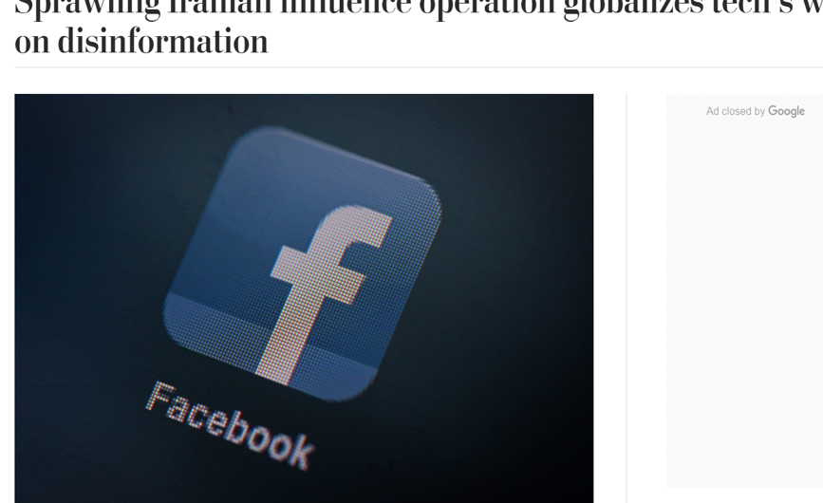
Globalizing False Information
Source: https://www.washingtonpost.com/technology/2018/08/21/russian-iran-created-facebook-pages-groups-accounts-mislead-users-around-world-company-says/

Slide 3
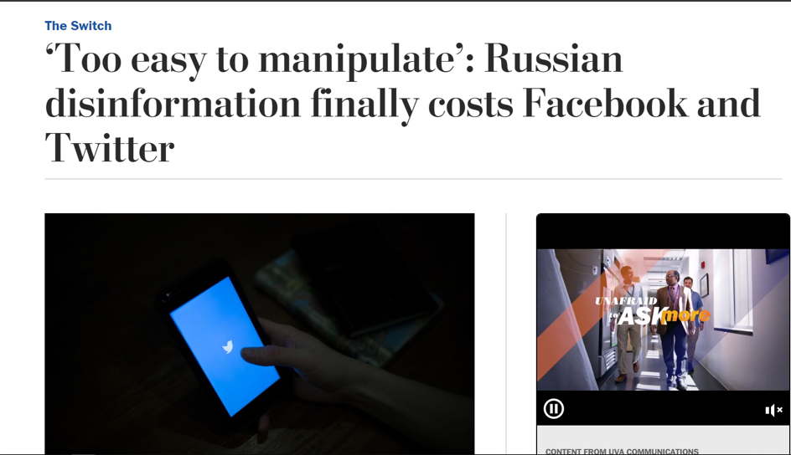
Russian Involvement Using Social Media
Source: https://www.washingtonpost.com/technology/2018/07/31/too-easy-manipulate-russian-disinformation-finally-costs-facebook-twitter/

Slide 4
The First Culprit: Internet Research Agency (IRA)
Group identity disclosed by Facebook
Influential campaign ordered by Vladimir Putin
Stationed in St. Petersburg
Facebook Influence:
3,393 advertisements
11.4 million American users exposed
470 IRA created Facebook pages
80,000 pieces of organic content on those pages
Organic content was exposed to 126 million Americans
Source: https://intelligence.house.gov/social-media-content/

Slide 5
Those Numbers Were Very Alarming
But What About Some Of The Advertisements?

Slide 6
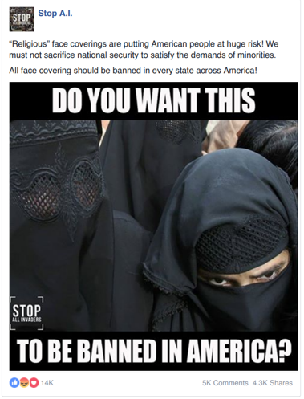
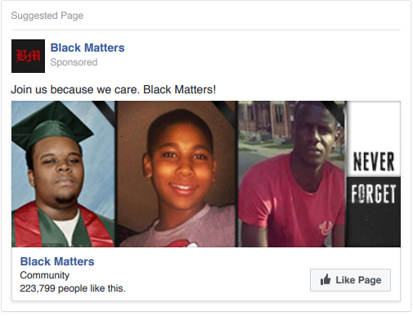
Controversial Facebook Ads
Source: https://intelligence.house.gov/uploadedfiles/fb_ad_black_matters.pdf
Source: https://intelligence.house.gov/uploadedfiles/1_of_3_stop_ai__1163765713737743.pdf

Slide 7
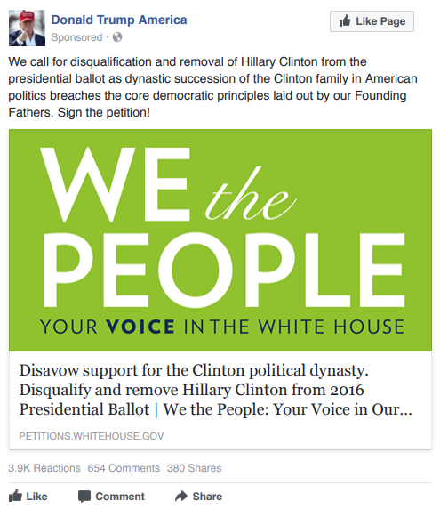
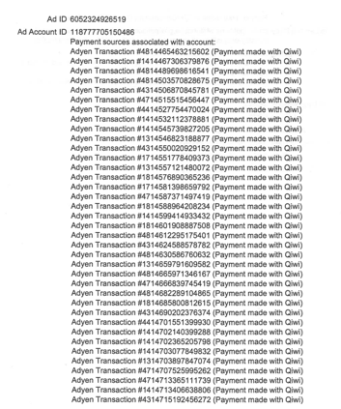
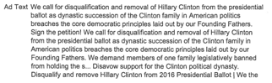
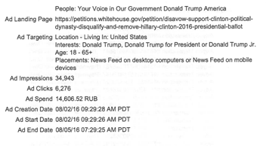
Facebook Ad And Metadata
14,606.52 RUB =~ 227.01 USD
Source: https://intelligence.house.gov/uploadedfiles/white_house_petition_metadata.pdf
Source: https://intelligence.house.gov/uploadedfiles/we_the_people_petition.pdf

Slide 8
But Is This Page Still Available?
Let’s Take A look At The Original Page

Slide 9
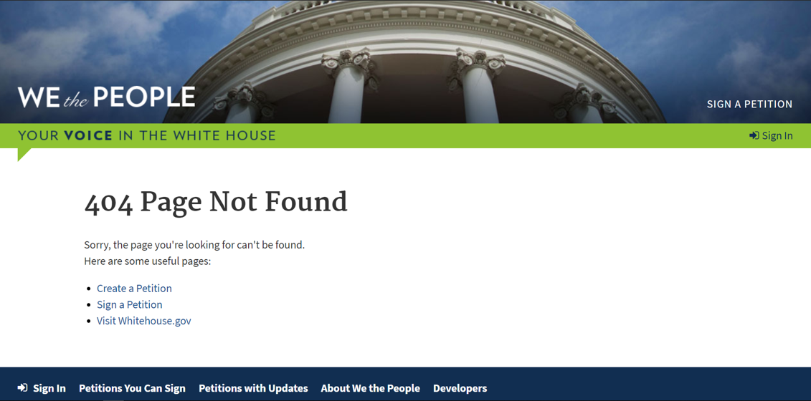
Page Unavailable
Source: https://petitions.whitehouse.gov/petition/disavow-support-clinton-political-dynasty-disqualify-and-remove-hillary-clinton-2016-presidential-ballot/

Slide 10
What Does The Internet Archive Show?
Let’s Find Out

Slide 11
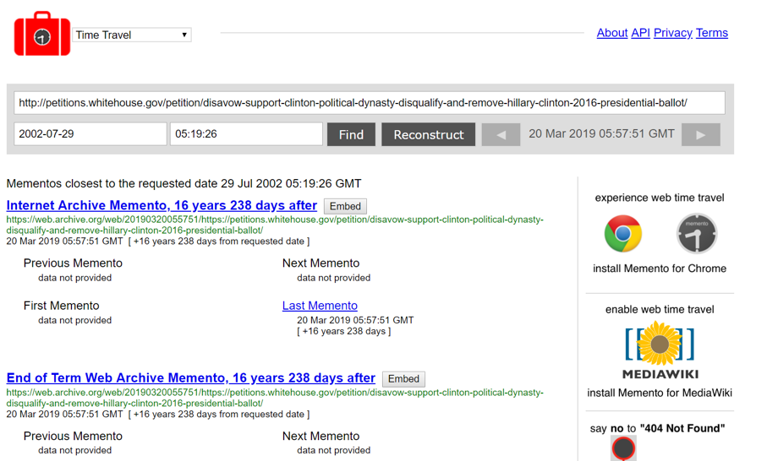
Mementos For Anti-Hillary Petition
Source: http://timetravel.mementoweb.org/list/20020729051926/https://petitions.whitehouse.gov/petition/disavow-support-clinton-political-dynasty-disqualify-and-remove-hillary-clinton-2016-presidential-ballot/

Slide 12
Maybe Twitter Can Give Us More Information
Let’s Look At Some Involved Twitter Handles

Slide 13
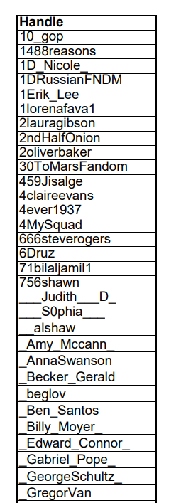
A Subset Of Associated Fake Twitter Accounts
Handles For Further Investigation:
@10_gop
@1488reasons
@1D_Nicole_
@1DRussianFNDM
@4MySquad
Source: https://intelligence.house.gov/uploadedfiles/ira_handles_june_2018.pdf

Slide 14
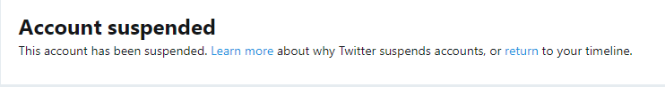
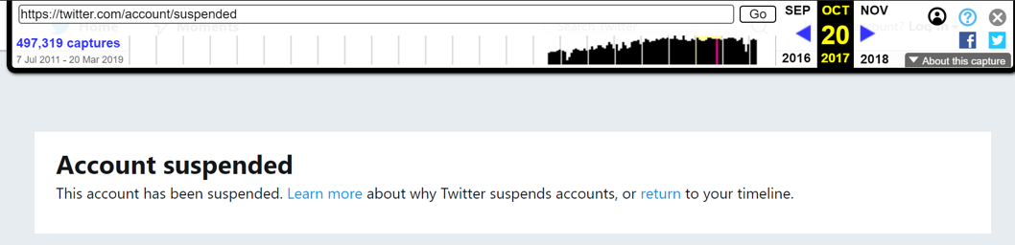
@10_gop
Source: https://twitter.com/10_gop
Based on 302 Redirect
Source: https://web.archive.org/web/20171020161602/https://twitter.com/10_gop

Slide 15
Used Memgator To Find Mementos For @10_gop
Only Non 302 Redirect

Slide 16
Memento For @10_gop From Archive.today
Source: http://archive.md/20171016053222/https://twitter.com/10_gop

Slide 17
Tweets and Retweets From @10_gop
Source: http://archive.md/20171016053222/https://twitter.com/10_gop

Slide 18
@10_gop Tweet Summary
Focuses content around President Trump information and Tweets
Retweets threads with bold headline
Little or no return comments to tweets/retweets

Slide 19
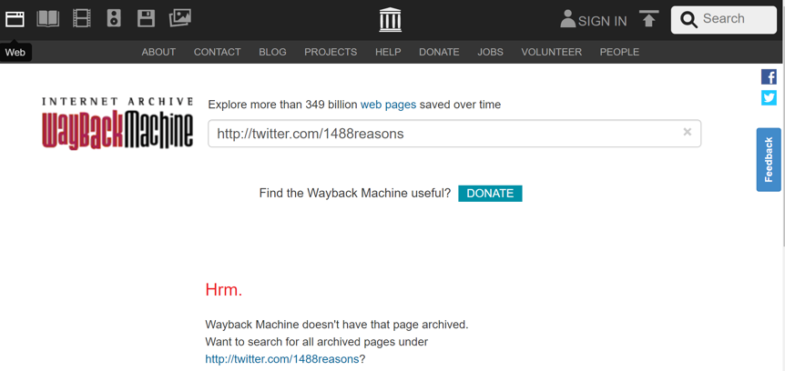
@1488reasons
Source: https://twitter.com/1488reasons
Not Archived
Source: https://web.archive.org/web/*/http://twitter.com/1488reasons

Slide 20
Used Memgator To Find Mementos for @1488reasons

Slide 21
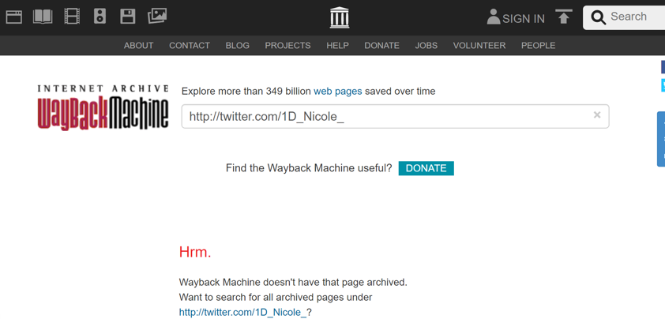
@1D_Nicole_
Source: https://twitter.com/1D_Nicole_
Not Archived
Source: https://web.archive.org/web/*/http://twitter.com/1D_Nicole_

Slide 22
Used Memgator To Find Mementos For @1D_Nicole_

Slide 23
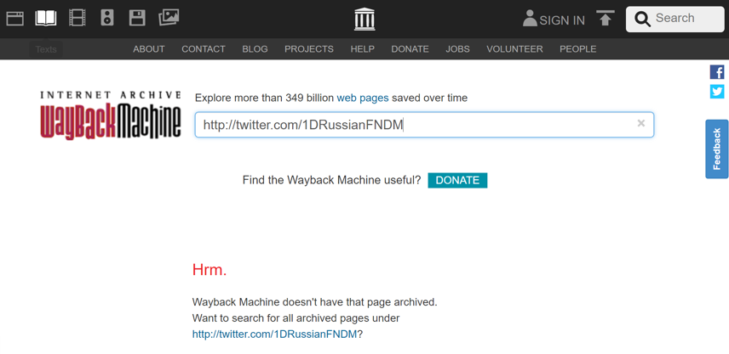
@ 1DRussianFNDM
Source: https://twitter.com/1DRussianFNDM
Not Archived
Source: https://web.archive.org/web/*/http://twitter.com/1DRussianFNDM

Slide 24
Used Memgator To Find Mementos For @1D_Nicole_

Slide 25
We Got Lucky With the Last Handle
The Account However Has Been Suspended From Twitter

Slide 26
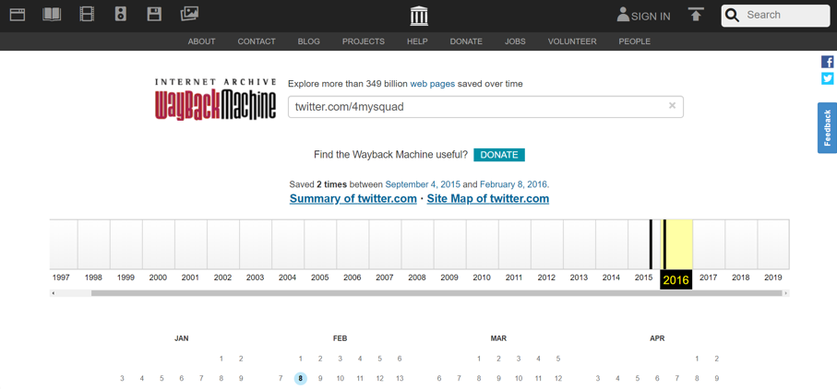
@4MySquad
Source: https://twitter.com/4MySquad
Source: https://web.archive.org/web/*/twitter.com/4MySquad

Slide 27
Two Entries Within The Archive
Let US Take A Look

Slide 28
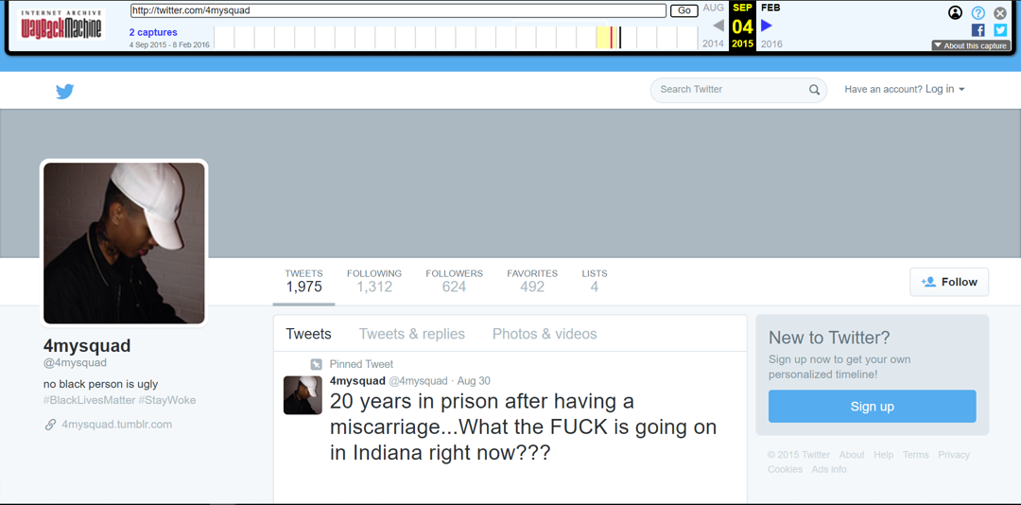
First Entry, 2015-09-04
Source: https://web.archive.org/web/20150904055426/twitter.com/4mysquad

Slide 29
Is This Account Part Of The IRA?
Let Us Review Some On This User’s Tweets

Slide 30
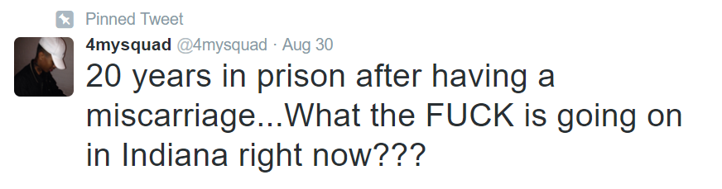
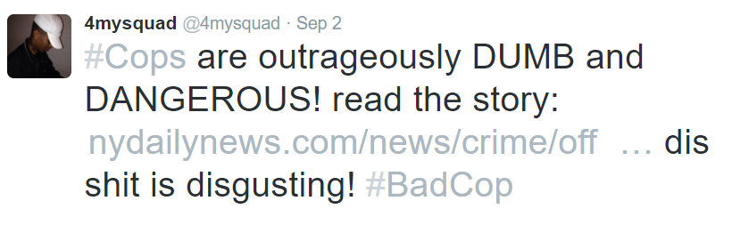
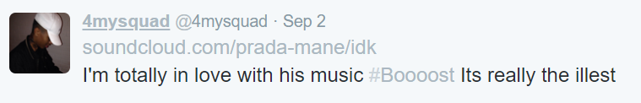
Most Recent Tweets From @4MySquad on 2019-09-05
Angry with a sentencing in Indiana based on a picture
Retweets an article of cops going to wrong house and people get shot
Retweets SoundCloud to a music link
Source: https://web.archive.org/web/20150904055426/twitter.com/4mysquad

Slide 31
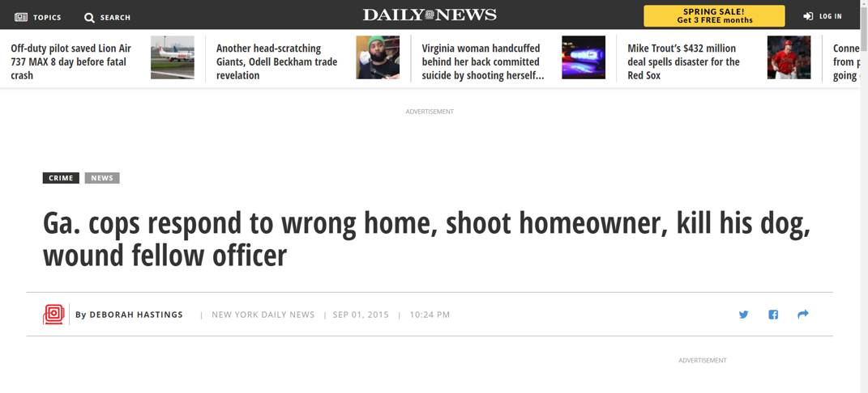
News Story From User’s Second Tweet Still Exists
Source: https://www.nydailynews.com/news/crime/officer-homeowner-shot-police-wrong-home-police-article-1.2343862

Slide 32
At First Glance, It Appears These Accounts Are Just Normal Users
But What About IN 2016?

Slide 33
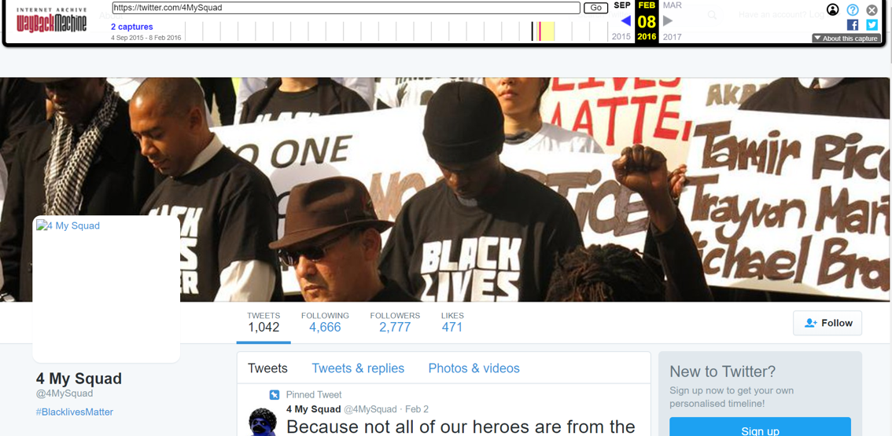
This User Page Already Has A Different Look And Feel, 2016-02-08
Source: https://web.archive.org/web/20160208193830/https://twitter.com/4MySquad

Slide 34
How Does This Account Compare To Each Of Its Mementos?
Let’s Look At Them Side By Side

Slide 35
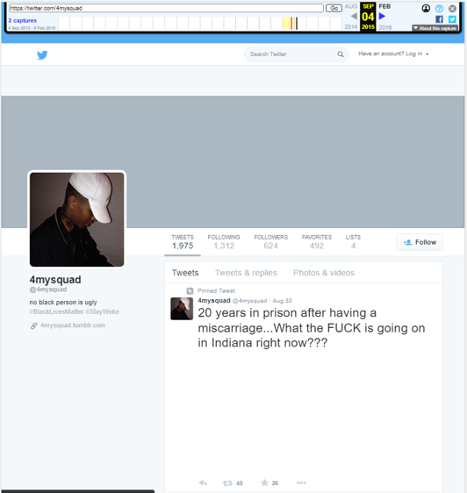
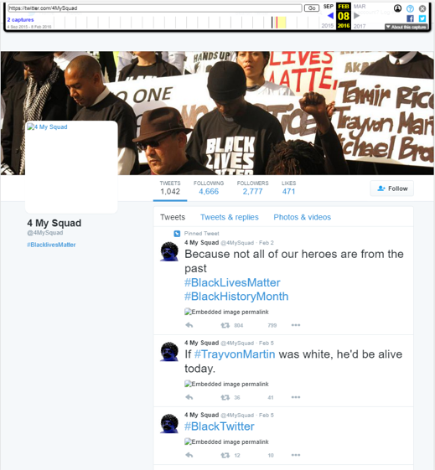
A Lot Has Changed Between These Accounts
Source: https://web.archive.org/web/20150904055426/twitter.com/4mysquad
Source: https://web.archive.org/web/20160208193830/https://twitter.com/4MySquad

Slide 36
Based On The Differences In The Accounts Within The Timeline
There Is Increased Activity Of The Account And More Politically Biased Posts Occur

Slide 37
Russia Is Old News
But What About The New Players Involved In Disinformation?

Slide 38
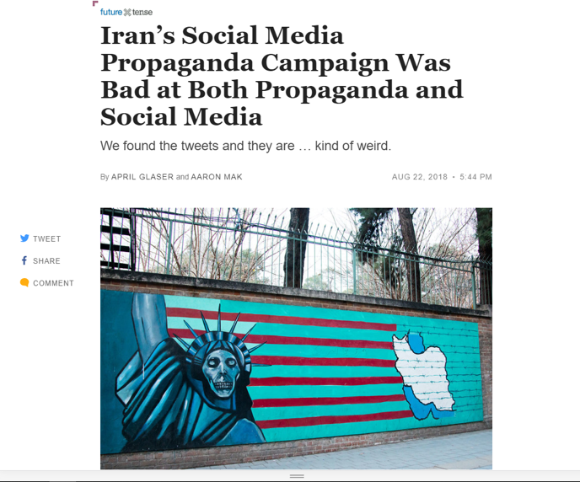
A New Media Campaign Arises
Source: https://slate.com/technology/2018/08/the-iranian-false-news-posts-on-facebook-and-twitter-were-not-very-convincing-or-good.html

Slide 39
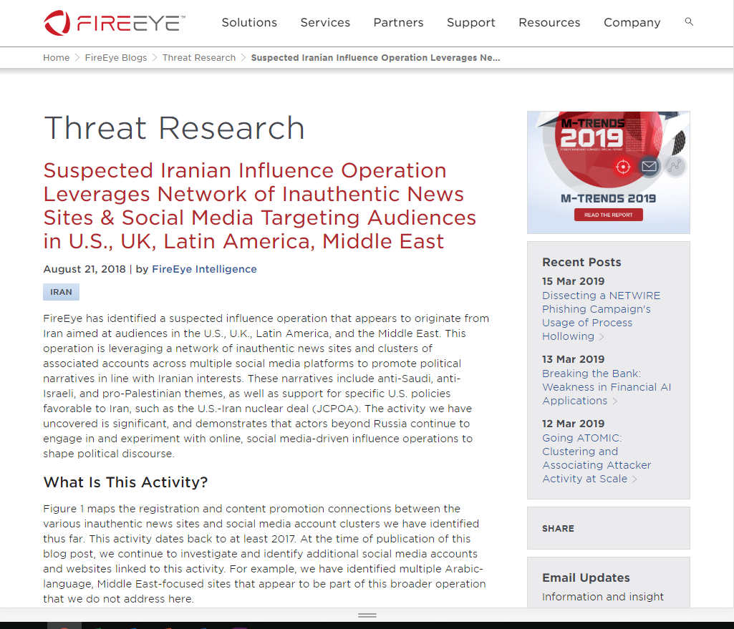
FireEye Gives A Tip Towards An Iranian Media Influence
Source: https://www.fireeye.com/blog/threat-research/2018/08/suspected-iranian-influence-operation.html

Slide 40
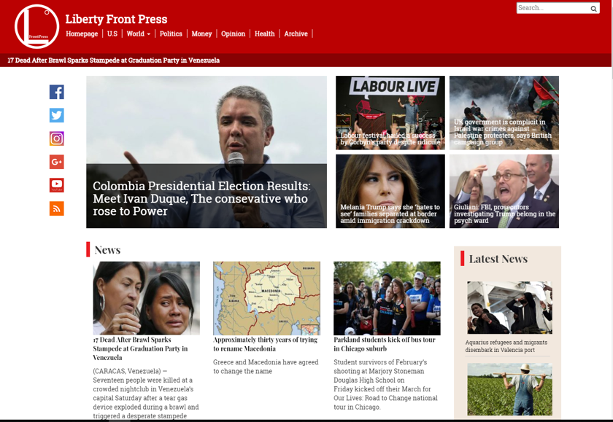
An Iranian News Site
Source: https://www.libertyfrontpress.com/

Slide 41
This News Site Has Social Media Links
Let’s Follow Them

Slide 42
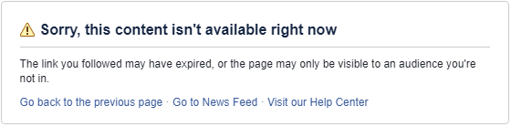
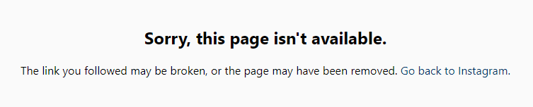
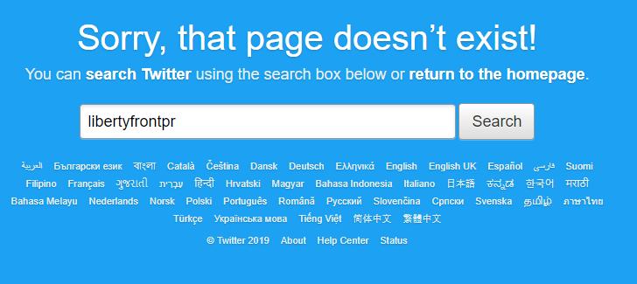
Social Media Results
Source: https://www.instagram.com/liberty_front_press/
Source: https://www.facebook.com/Libertyfrontpress-410534109315563/
Source: https://twitter.com/libertyfrontpr

Slide 43
All Return 404’s From Twitter

Slide 44
Memgator Returns No Mementos For Twitter Handle
This User No Longer Exists

Slide 45
It Is Quite Strange That A News Site Would Allow Broken Links On Their Main Page
Is There A Reason They Haven’t Been Corrected?

Slide 46
Maybe We Can Try Another Method With Twitter
Let’s Search For The News Site

Slide 47
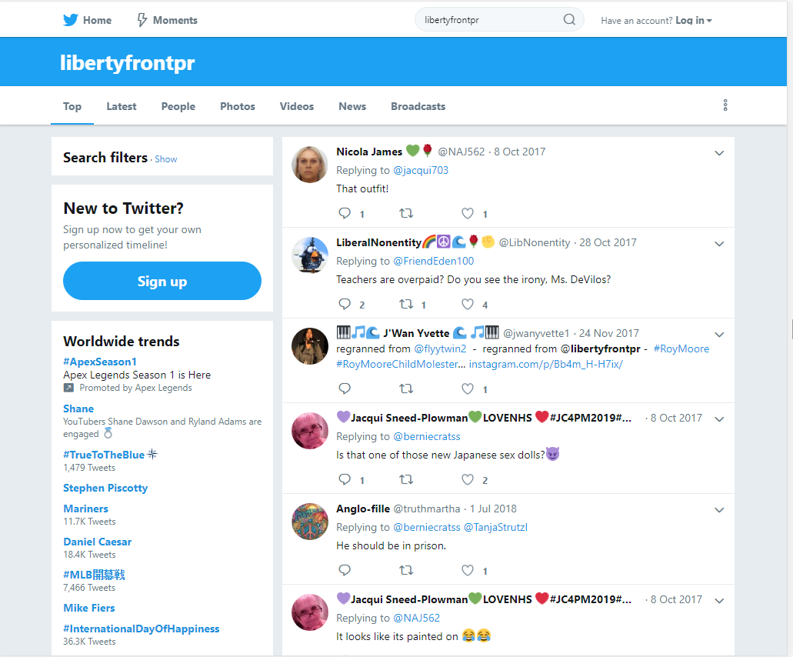
Twitter Search Results
Source: https://twitter.com/search?q=libertyfrontpr

Slide 48
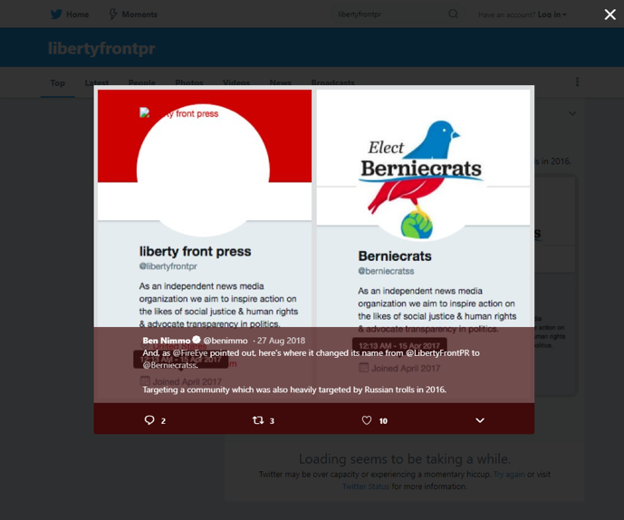
A New Identity Linked To LFP News Site?
Source: https://twitter.com/search?q=libertyfrontpr

Slide 49
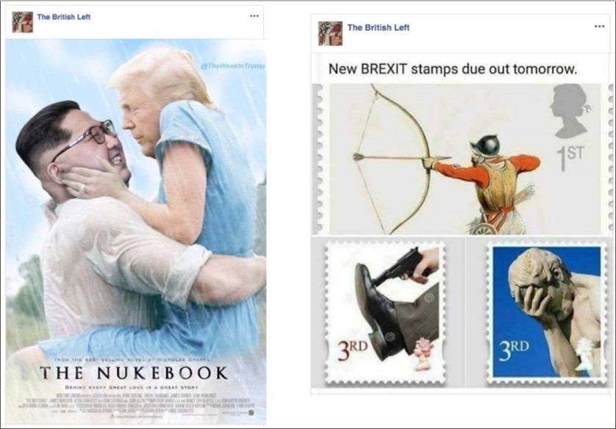
Photos Spreading Propaganda
Source: https://mobile.twitter.com/mathewjschwartz/status/1032217384776593408/photo/1

Slide 50
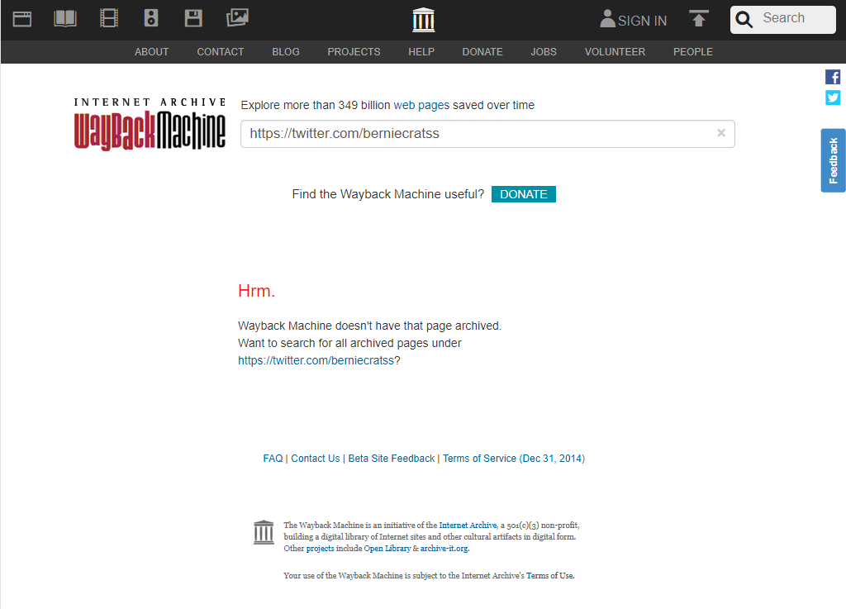
Current State Of @berniecratss Account
Source: https://twitter.com/berniecratss
Source: https://web.archive.org/web/*/https://twitter.com/berniecratss

Slide 51
Global Efforts Towards Misinformation
Russia is not alone in creating misinformation
Tweets from IRA associated accounts propagate content based on controversial subject matter
There is not enough evidence available to determine the vastness or complexity of Liberty Front Press
Known social media accounts of Liberty Front Press are not available and non existent within the archive
Liberty Front Press is sloppy at covering tracks to further extort their operation

Slide 52
Contact Information:
Github: https://github.com/mst3v3nsn
Google Groups: https://groups.google.com/forum/#!forum/cs895-s19

